Slide 1

Our Project

Slide 2

VIDEO INTRODUCTIONS
Hunter will now show us Unity’s “First Game” video.
Jordan will now provide an addition to that video: https://youtu.be/MuD7eLyfPMg

Slide 3
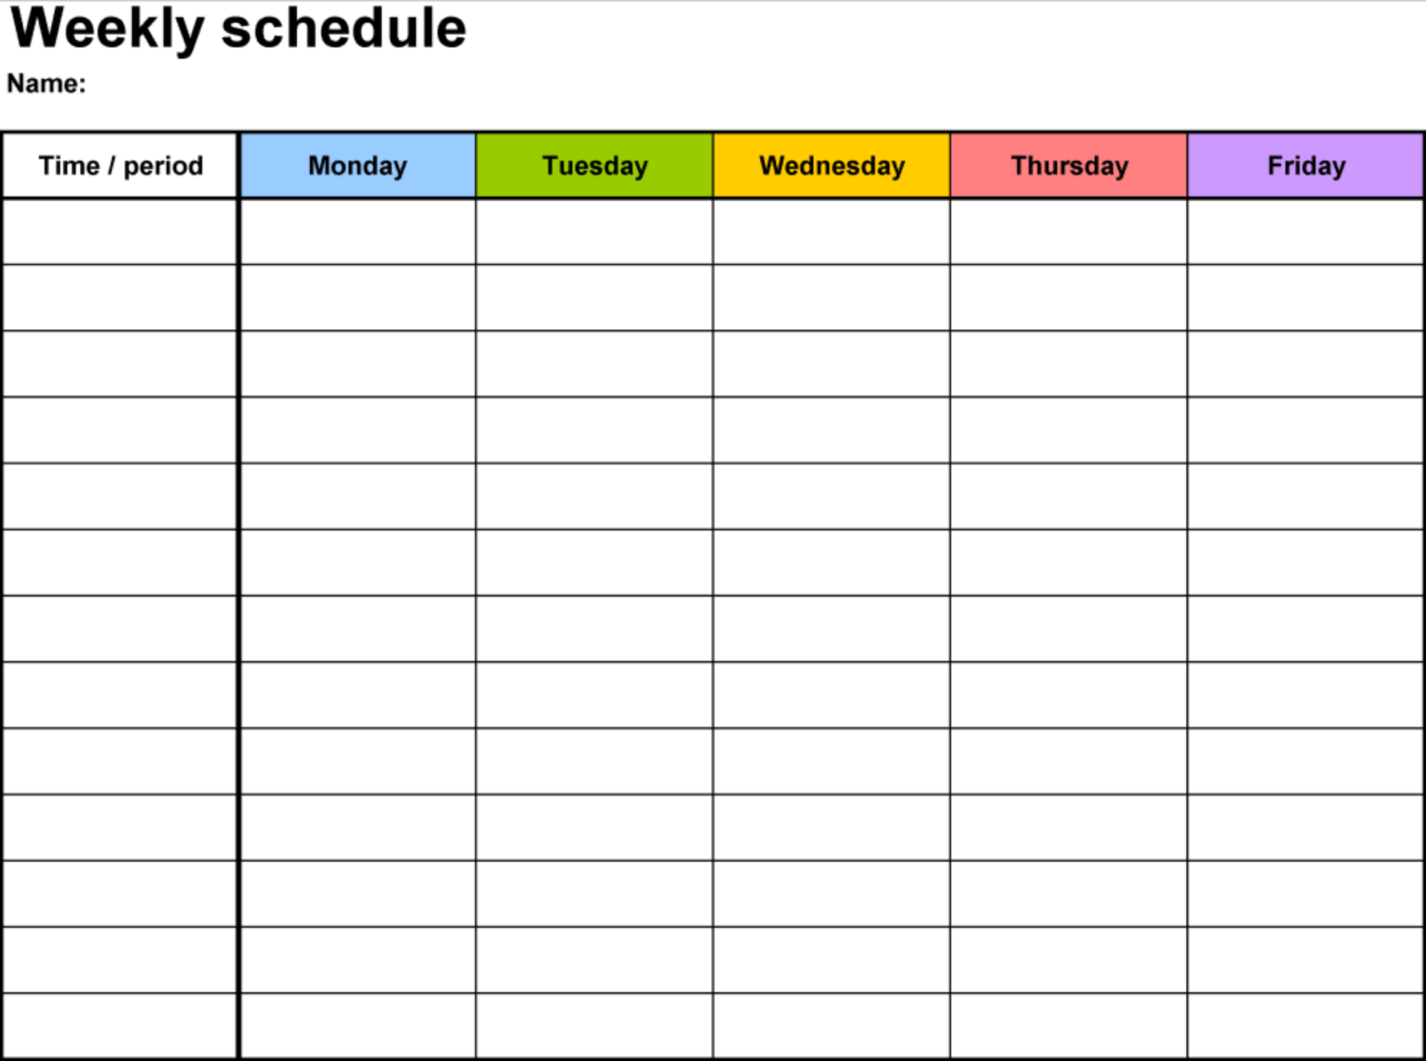
GROUP SCHEDULE

Slide 4

LEARNING
What is it that you expect to learn from this project?
What is something you want to learn from this project that we have not included?
What are you most excited about?
Are there any software purchases that we should consider?

Slide 5
What is GitHub?
GitHub is a common and very much needed way of providing version control to team projects. With this we can provide updates to our project as a team without interfering with one another’s individual tasks. How is this possible?
In GitHub there is a feature called a branch. A branch will represent your individual “station” (I made station up, yay me). I used this term because I feel that it explains it best. In our “stations” or what we should actually call branches, we will have our own individual work. This individual work should have no way of interrupting other people’s projects.
These branches should be categorized with at least three: master, feature, and a team member’s branch. In our case, we should have at least four: master, feature, Hunter’s project and Jordan’s project.
Here’s an example: Hunter is working on the player’s movement, and I am working on the map. Therefore, Hunter’s branch will be called PlayerMovement and my branch will be PlayerCollision. We both finish our projects and push them onto the feature branch only to find that we have problems because the player’s movement interferes with the world! How do we solve this issue? Hunter’s branch should be named PlayerMovement / PlayerCollision and I should have a completely unrelated project, SaveData / LoadData.

Slide 6
VERSION CONTROL
Hunter will talk about how versions of our project should be laid out.
Jordan will now demonstrate the team’s GitHub repository: https://github.com/jorrtayl/Group-Project

Slide 7
PROJECT PLANNING
TRELLO LAYOUT
GAME ENGINE
GAME GENRE
Trello is a team-building website that will help us with organizing and assigning tasks between different divisions of the group project. Before we begin finalizing our Trello, we should produce a plan of action for the layout of how things are arranged. Let’s not discuss this right now, as Hunter and I have concluded some ideas for this layout in the future slides.
We’ve agreed to use Unity for this project. Unity has a nice layout for programming, animations, addition for models, and textures. This is ideal for the programmers because both programmers, Hunter and Jordan, prefer using C# and Unity uses C#. This language is common in the real world and is faster than Unity’s competitor, Unreal Engine, because it uses C++. For the other three: animations, models, and textures, Unity provides folders that will aid in the organization between your assets.
The game genre for this project should be consulted with the group and agreed on the behalf of all members. Similarly, with what we previous talked about with Trello, there will be slides with video game ideas. Once we have reviewed these ideas we can add or agree on what appears to be the best. If the idea we decide on deems too easy that is fine, we do not have to settle with a single video game. Once we have reviewed our options and agreed on the game idea, we can then decide what genre it falls under.

Slide 8
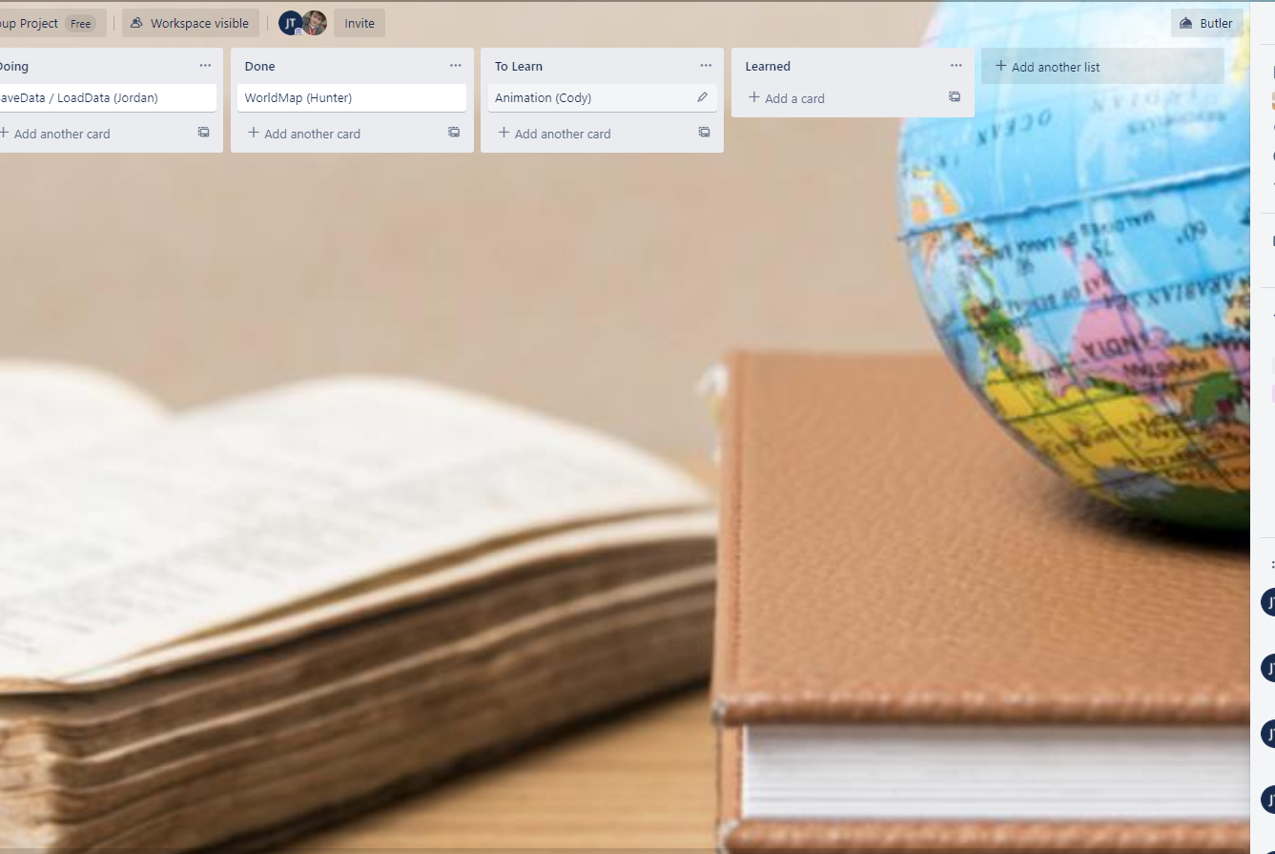
Trello Suggestion #1: Learning Format

Slide 9
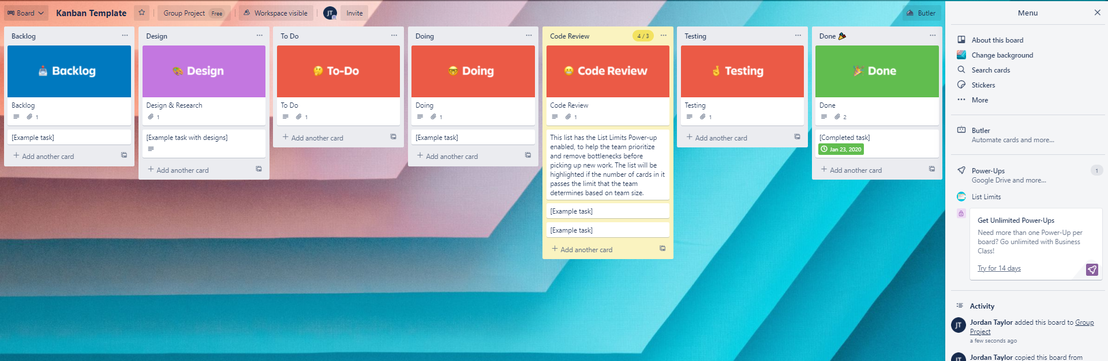
Trello Suggestion #2: Team Collaborative

Slide 10
Game Idea: Dragon World (Medium Scale)
This game idea was inspired by the game: Sonic Adventure 2: Battle. In this game, every zone the player enters will be a “dome”. These domes vary in sizes and tries to capture the idea of somehow being “open-world” by showing the player a much larger world outside of the dome.
Aside from the menu system, at launch the player will spawn inside of a dome where there will be multiple doors all around in a circular fashion. Each door representing an entirely different dome.
The current thoughts on these domes will be three gardens for the dragons: Haven, Hell, and Peace which are unlocked based on the evolution of your dragon. For instance, if your baby dragon evolves into an evil dragon, then you unlocked Hell as a garden. Other doors will be a lot different than these gardens, as they will be full of nature consisting of: trees, water, rocks, plants, dragons, and dragon nests containing eggs. Inside these gardens you will be able to feed your dragons to improve their stats (these will be discussed later).
The other doors will include: schooling to teach the dragons how to do different actions such as music or drawing, NPC vendors that allow purchasing of different eggs, seeds (for plants and trees), fruits, a Doctor NPC, a name changer NPC, an arena for dragon combat, and whatever comes to mind. The options are truly endless!
These dragons will also have stat values that are separated into two categories: combat and racing. The stats will be shown when the dragon is interacted with. The next slide will provide an image representing this. Now, these are the current stats that were considered for combat: health, high dodge, low dodge, punch (countered with high dodge), kick (countered with low dodge), and energy (prevents the dragon from napping during the fight). As for the racing skills: swimming, flying, running, strength, and energy.
These dragons can breed with other dragons and considering life today gender will not matter but we can still include gender. The stats will have ranks that can be displayed in someway and these affect the “level value”. Level value will be seen in the next slide. In breeding you can expect the offspring to have a little bit of every random values from the parents. These traits will not follow the rules of genetics in real life, but instead completely randomized. As an example, the swimming grade of one parent is ranked an A and the other parent a C. The offspring will compare these two and randomly choose which one to acquire for swimming.
The player can obtain fruit and other various items for the dragons that are obtained from the dragons winning races and fights. Each fruit providing a specific stat increase, but no fruit can improve the grade of the dragon. The only way to improve the grade is through luck from the market and from the original spawned eggs inside the gardens.

Slide 11
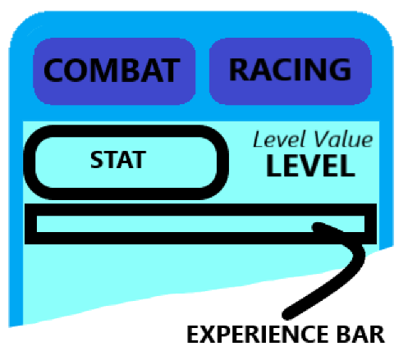
STAT UI FOR DRAGON WORLD

